Slide 1
Randomized Algorithms CS648
Lecture 3
Linearity of Expectation with applications
(the most important tool for analyzing randomized algorithms)

Slide 2
RECAP from the last lecture
the balls out of bin problem
We will discuss it at the end ☺
Let us first re-invent the powerful tool “Linearity of expectation”.

Slide 3

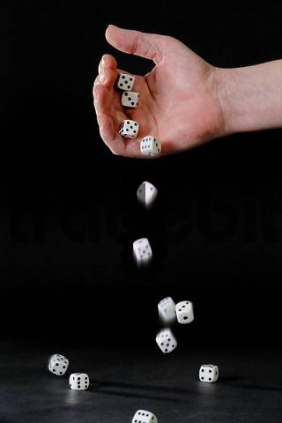
Random variable
Randomized-Quick-Sort
on array of size n
Number of HEADS in 5 tosses
Sum of numbers in 4 throws
Number of comparisons

Slide 4

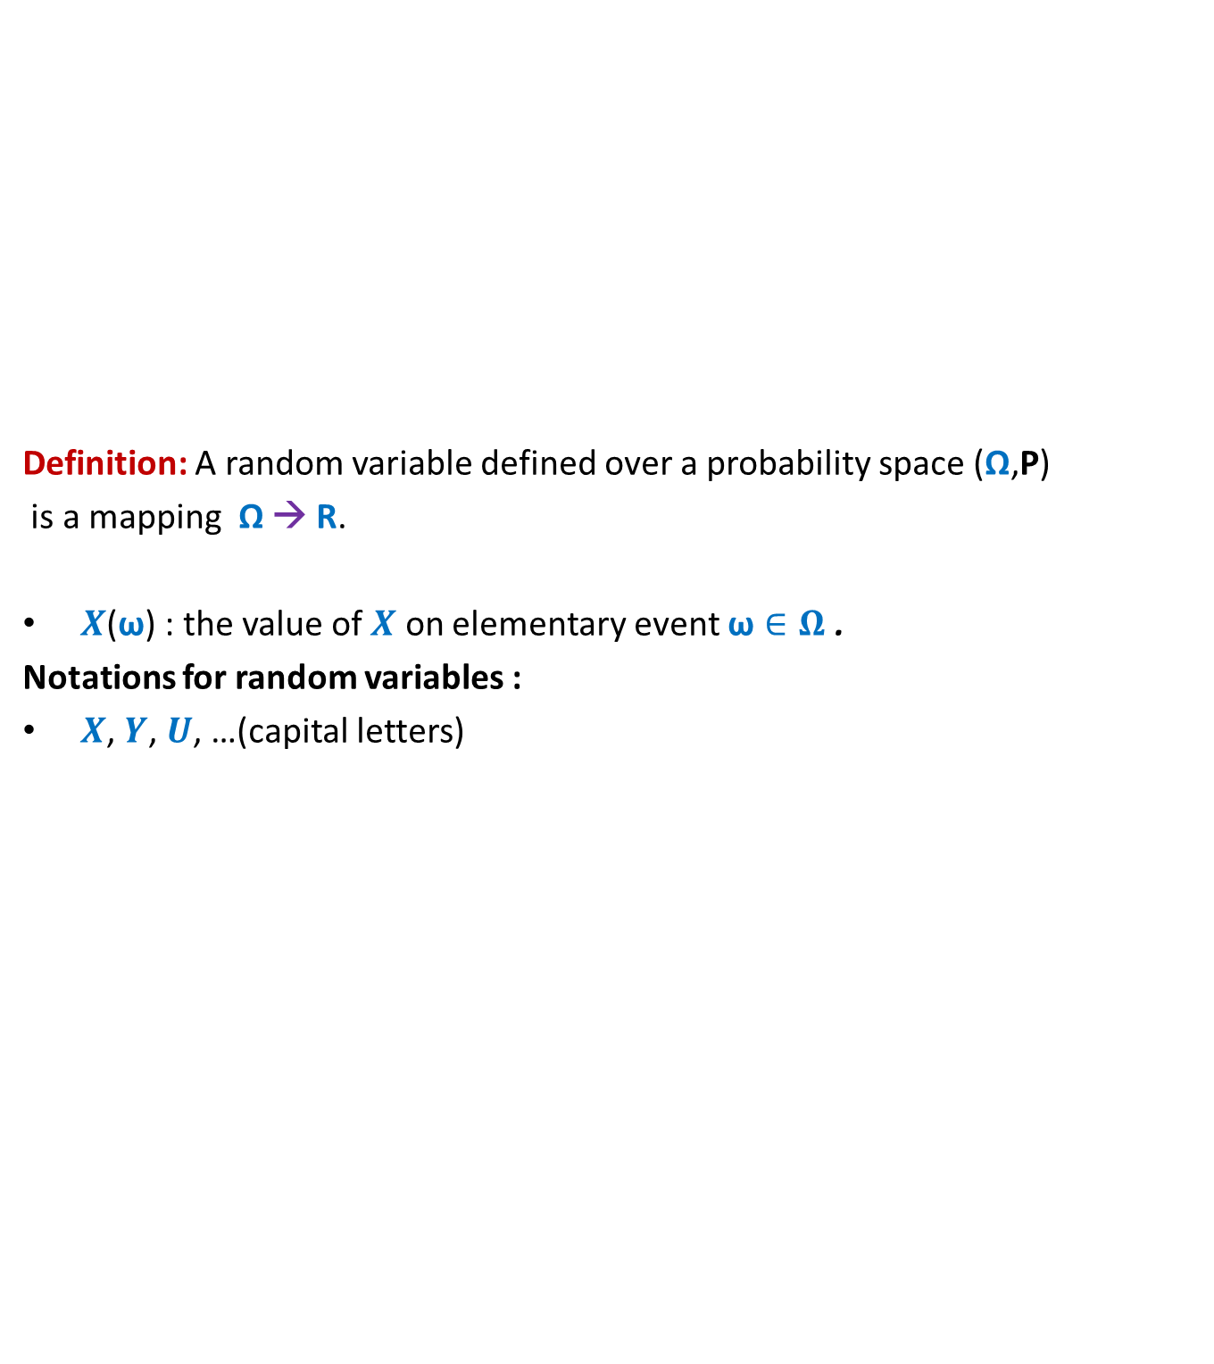
Random variable
Definition: A random variable defined over a probability space (Ω,P)
is a mapping Ω → R.
$X$($\text{ω}$) : the value of $X$ on elementary event $\text{ω}∈Ω$ .
Notations for random variables :
$X$, $Y$, $U$, …(capital letters)
$$X$$
Set of real numbers
R
Ω

Slide 5
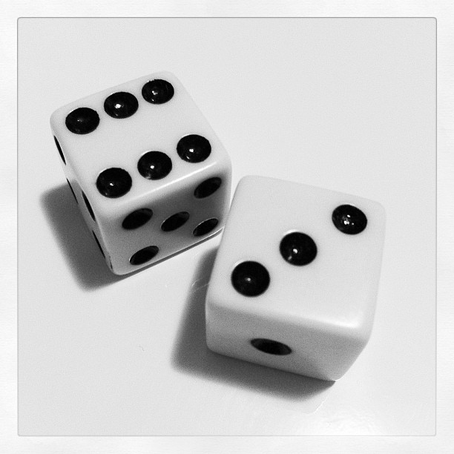
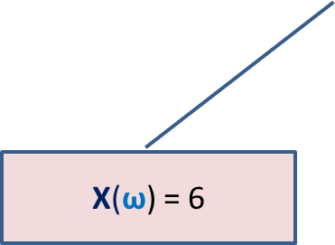
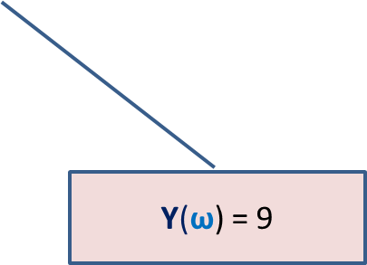

Many Random Variables for the same Probability space
Random Experiment: Throwing a dice two times
X : the largest number seen
Y : sum of the two numbers seen
X($\text{ω}$) = 6
$$\text{ω}$$
Y($\text{ω}$) = 9

Slide 6
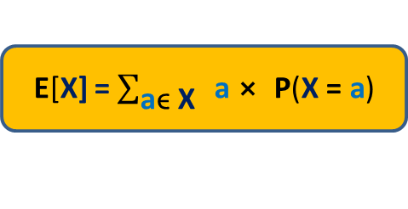

Expected Value of a random variable
Definition:
Expected value of a random variable X defined over a probability space (Ω,P) is
E[X] = $\sum_{\text{ω}\text{ϵ} \text{Ω}}{\text{X}\text{(}\text{ω}\text{)}⨯ \text{P}\text{(}\text{ω}\text{)}}$
X= c
Ω
X= a
X= b
E[X] = $\sum_{\text{a}\text{ϵ} \text{X}}{ \text{a}⨯ \text{P}\text{(}\text{X}\text{ = }\text{a}\text{)}}$

Slide 7
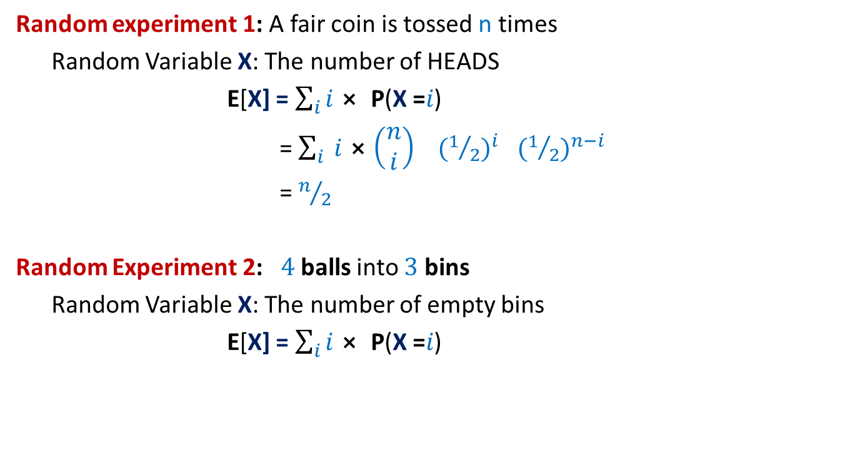
Examples
Random experiment 1: A fair coin is tossed n times
Random Variable X: The number of HEADS
E[X] = $\sum_{i}{i⨯ \text{P}\text{(}\text{X}\text{ =}i\text{)}}$
= $\sum_{i}{ i⨯\left(\begin{matrix}n \\ i\end{matrix}\right)}{ (1/2)}^{i}{ (1/2)}^{n−i}$
= $n/2$
Random Experiment 2: $4$balls into $3$ bins
Random Variable X: The number of empty bins
E[X] = $\sum_{i}{i⨯ \text{P}\text{(}\text{X}\text{ =}i\text{)}}$

Slide 8

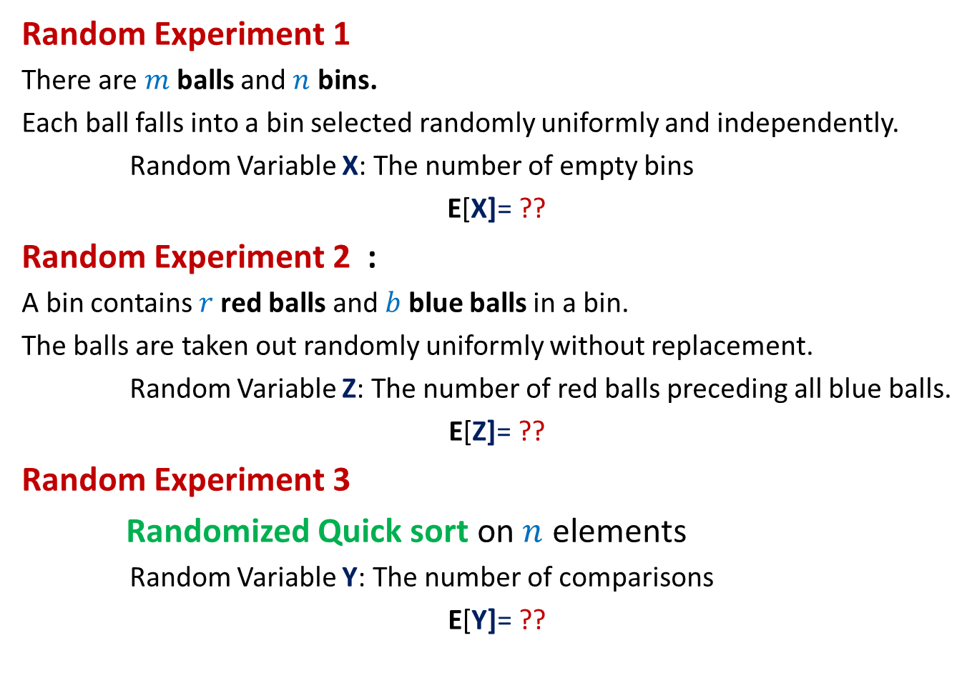
Can we solve these problems ?
Random Experiment 1
There are $m$balls and $n$ bins.
Each ball falls into a bin selected randomly uniformly and independently.
Random Variable X: The number of empty bins
E[X]= ??
Random Experiment 2 :
A bin contains $r$red balls and $b$ blue balls in a bin.
The balls are taken out randomly uniformly without replacement.
Random Variable Z: The number of red balls preceding all blue balls.
E[Z]= ??
Random Experiment 3
Randomized Quick sort on $n$ elements
Random Variable Y: The number of comparisons
E[Y]= ??
Homework

Slide 9
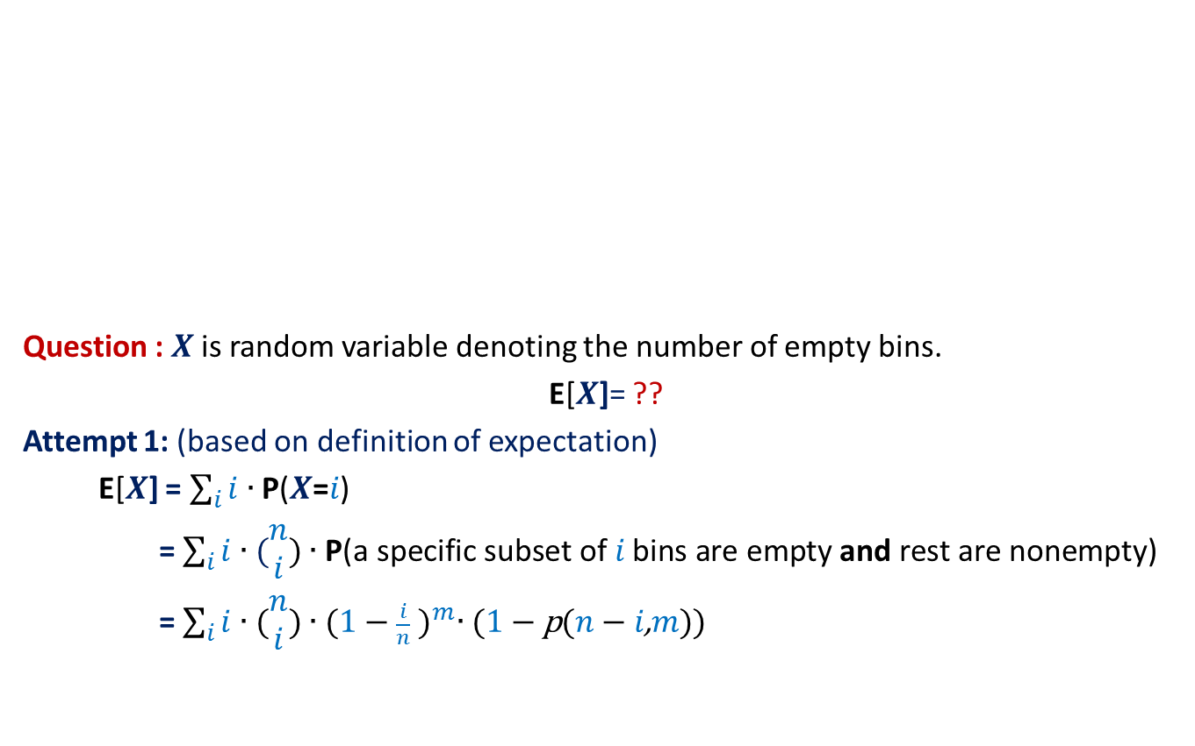


Balls into Bins (number of empty bins)
1 2 3 4 5 … $m−1$ $m$
Question : $X$ is random variable denoting the number of empty bins.
E[$X$]= ??
Attempt 1: (based on definition of expectation)
E[$X$] = $\sum_{i}{i∙\text{P}\text{(}X\text{=}i\text{)}}$
= $\sum_{i}{i∙(\begin{matrix}n \\ i\end{matrix}\text{)}∙\text{P}\text{(}\text{a} \text{specific} \text{subset} \text{of} i \text{bins} \text{are} \text{empty} \text{and} \text{rest} \text{are} \text{nonempty}\text{)}}$
= $\sum_{i}{i∙(\begin{matrix}n \\ i\end{matrix}\text{)}∙{(1−\frac{i}{n} )}^{m}∙\text{(}\text{1}−\text{p}\text{(}n−i\text{,}m\text{))}}$
A subset of $i$ bins
1 2 3 … … $n$
This is a right answer.
But it is useless !

Slide 10

Randomized Quick Sort (number of comparisons)
Question : Y is random variable denoting the number of comparisons.
E[Y]= ??
Attempt 1: (based on definition of expectation)
E[Y] = $\sum_{i}{i∙\text{P}\text{(}\text{Y}\text{ =}i\text{)}}$
A recursion tree
associated with Randomized Quick Sort
We can not proceed from this point …☹

Slide 11

Since viewing the random experiment in its entirety looks so complex, let us take a microscopic view.
Balls into Bins (number of empty bins)
1 2 3 4 5 … $m−1 m$
1 2 3 … … $n$
Randomized Quick Sort (number of comparisons)

Slide 12

Balls into Bins (number of empty bins)
$$1 2 3 4 5 … m−1 m$$
Question: Let $X_{i}$ be a random variable defined as follows.
$X_{i}$ = $\left\{\begin{matrix}1 if ith bin is empty \\ 0 otherwise \end{matrix}\right.$
What is E[$X_{i}$] ?
Answer : E[$X_{i}$] = $1$ $∙$ $\text{P}\text{(}ith bin is empty\text{) }$ + $0$ $∙$ $\text{P}\text{(}ith bin is not empty\text{) }$
= $\text{P}\text{(}ith bin is empty\text{)}$
= ${(1−\frac{1}{n} )}^{m}$
1 2 3 … $i$ … $n$

Slide 13




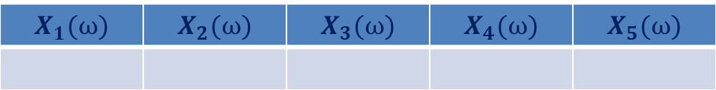
Balls into Bins (any relation between $X$ and $X_{i}$’s ?)
Consider any elementary event.
$X\left(ω\right)=2$
1 2 3 4 5 6
An elementary event
$$ω$$
number of empty bins
1 2 3 4 5
$$X_{1}(ω)$$ | $$X_{2}(ω)$$ | $$X_{3}(ω)$$ | $$X_{4}(ω)$$ | $$X_{5}(ω)$$
0
1
0
1
0
$X\left(ω\right)=$ $X_{1}\left(ω\right)+$ $X_{2}\left(ω\right)+$ $X_{3}\left(ω\right)+$ $X_{4}\left(ω\right)+$ $X_{5}\left(ω\right)$
for each $ω$ ϵ Ω

Slide 14

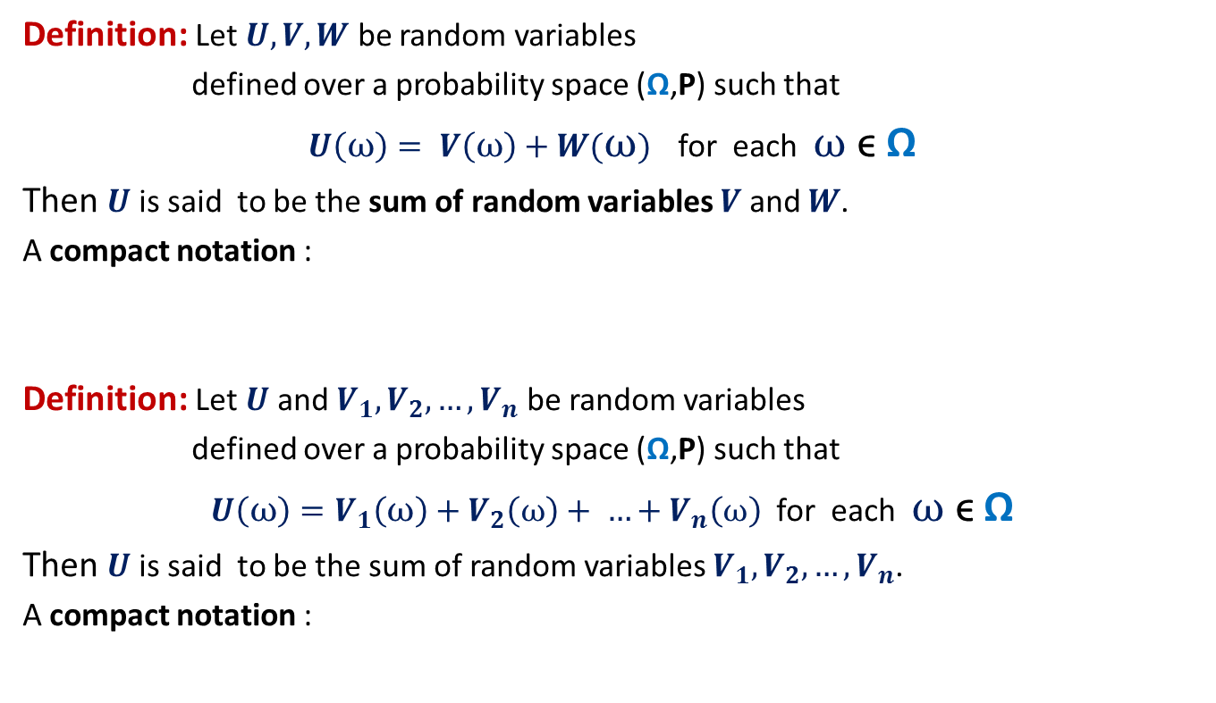

Sum of Random Variables
Definition: Let $U,V,W$ be random variables
defined over a probability space (Ω,P) such that
$U\left(ω\right)= V\left(ω\right)+W(ω)$ for each $ω$ ϵ Ω
Then $U$ is said to be the sum of random variables $V$ and $W$.
A compact notation :
Definition: Let $U$and $V_{1},V_{2},…,V_{n}$ be random variables
defined over a probability space (Ω,P) such that
$U\left(ω\right)=V_{1}\left(ω\right)+V_{2}\left(ω\right)+ …+V_{n}\left(ω\right)$ for each $ω$ ϵ Ω
Then $U$ is said to be the sum of random variables $V_{1},V_{2},…,V_{n}$.
A compact notation :
$$U=V+W$$
$$U=V_{1}+V_{2}+…+V_{n}$$

Slide 15

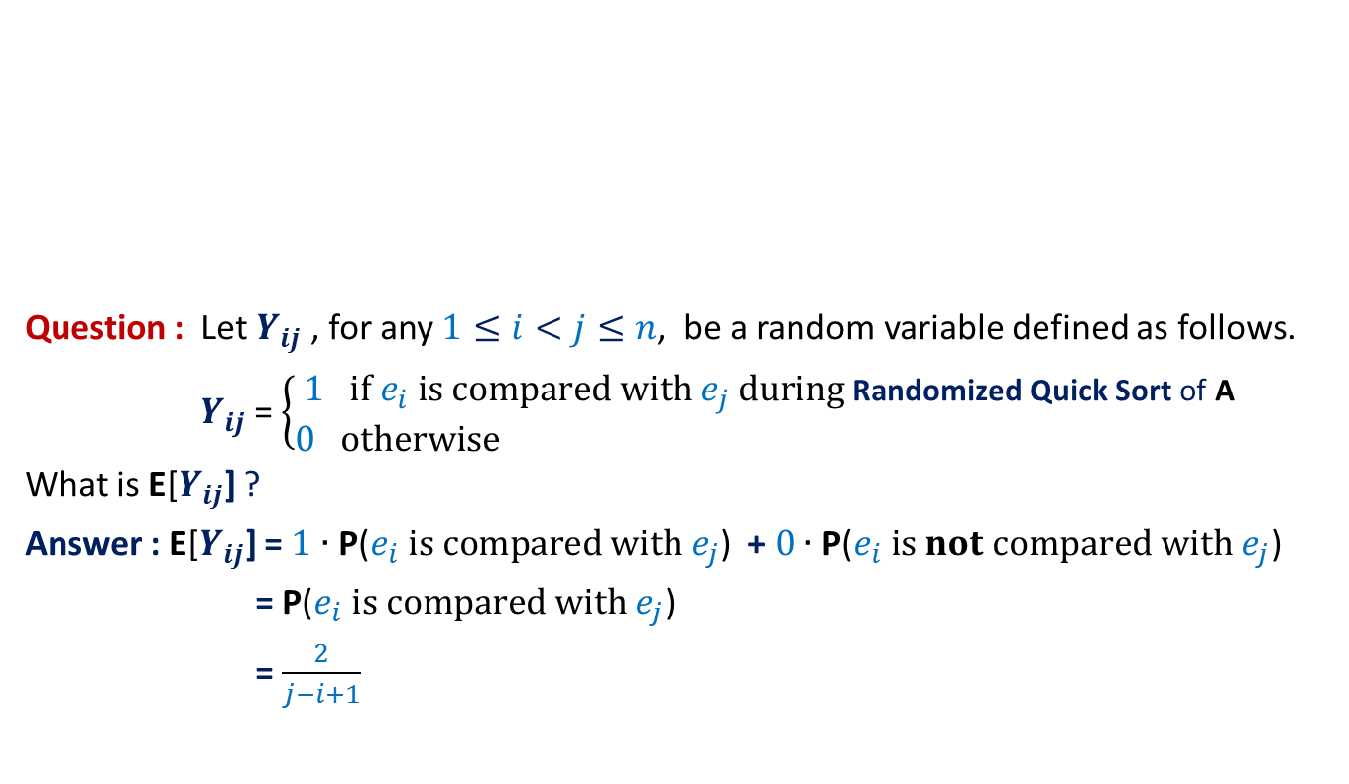
Randomized Quick Sort (number of comparisons)
Elements of A arranged in Increasing order of values
$$e_{i}$$
Question : Let $Y_{ij}$ , for any $1≤i<j≤n$, be a random variable defined as follows.
$Y_{ij}$ = $\left\{\begin{matrix}1 if e_{i} is compared with e_{j} during \text{Randomized} \text{Quick} \text{Sort} \text{of} \text{A} \\ 0 otherwise \end{matrix}\right.$
What is E[$Y_{ij}$] ?
Answer : E[$Y_{ij}$] = $1$ $∙$ $\text{P}\text{(}e_{i} is compared with e_{j}\text{)}$ + $0$ $∙$ $\text{P}\text{(}e_{i} is not compared with e_{j}\text{) }$
= $\text{P}\text{(}e_{i} is compared with e_{j}\text{)}$
= $\frac{2}{j−i+1}$

Slide 16
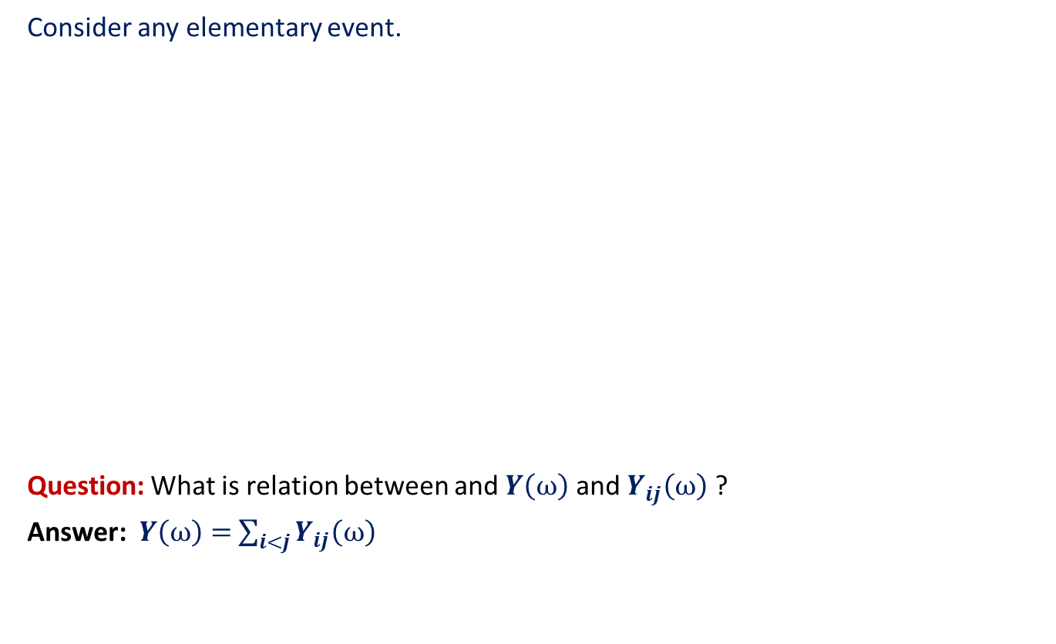



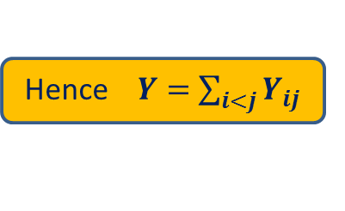
Randomized Quick Sort (any relation between $Y$ and $Y_{ij}$’s ?)
Consider any elementary event.
Question: What is relation between and $Y\left(ω\right)$ and $Y_{ij}\left(ω\right)$ ?
Answer: $Y\left(ω\right)=$ $\sum_{i<j}{Y_{ij}\left(ω\right)}$
Any elementary event
$$ω$$
$Y_{12}(ω){ Y}_{13}(ω)$ … $Y_{1n}(ω)$ $Y_{23}(ω)$ $Y_{24}(ω)$ … $Y_{n−1 n}(ω)$
1 0 … 0 1 1 … 0
for each $ω$ ϵ Ω
Hence $Y=$ $\sum_{i<j}{Y_{ij}}$
number of comparisons

Slide 17
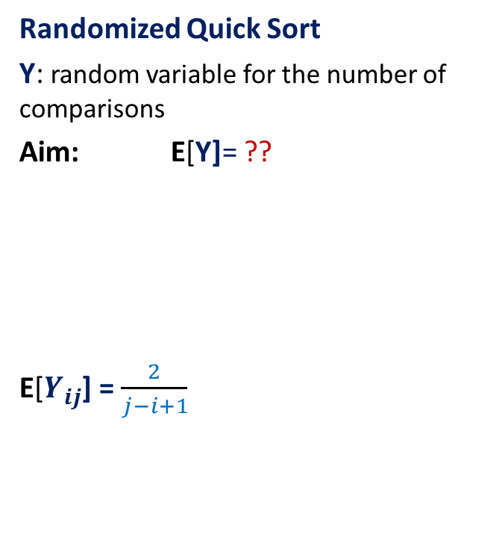

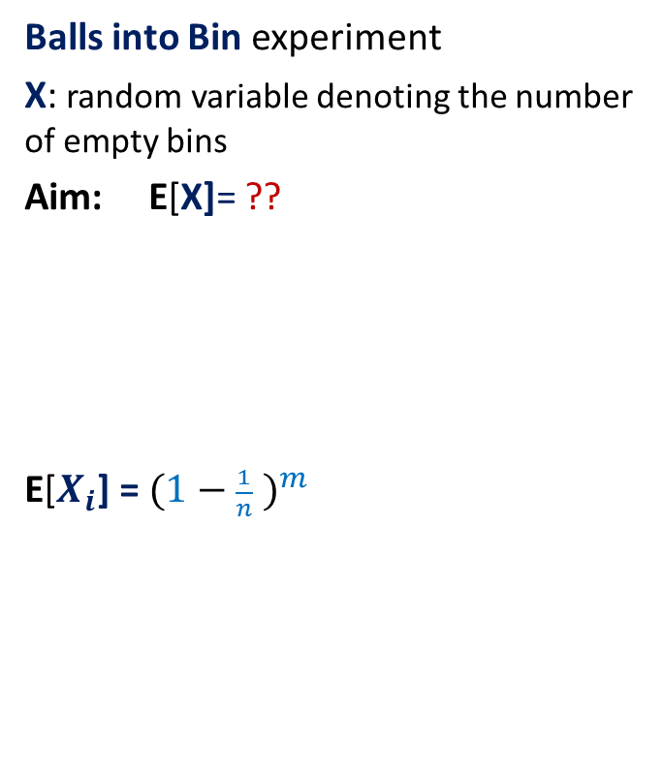
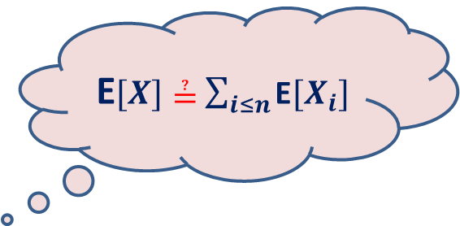
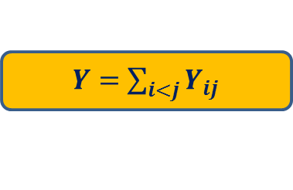
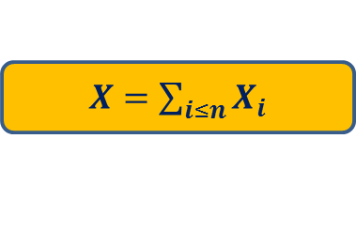
What have we learnt till now?
Balls into Bin experiment
X: random variable denoting the number of empty bins
Aim: E[X]= ??
E[$X_{i}$] = ${(1−\frac{1}{n} )}^{m}$
Randomized Quick Sort
Y: random variable for the number of comparisons
Aim: E[Y]= ??
E[$Y_{ij}$] = $\frac{2}{j−i+1}$
$X=$ $\sum_{i≤n}{X_{i}}$
$Y=$ $\sum_{i<j}{Y_{ij}}$
E$[X]≟$ $\sum_{i≤n}{\text{E}[X_{i}]}$
E$[Y]≟$ $\sum_{i<j}{\text{E}[Y_{ij}]}$

Slide 18
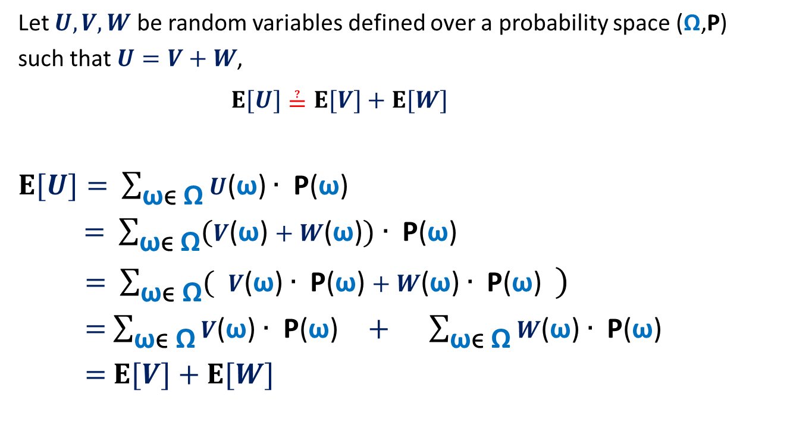
The main question ?
Let $U,V,W$ be random variables defined over a probability space (Ω,P)
such that $U=V+W$,
$E[U]≟E[V]+E[W]$
$E[U]=$ $\sum_{\text{ω}\text{ϵ} \text{Ω}}{U\text{(}\text{ω}\text{)}∙ \text{P}\text{(}\text{ω}\text{)}}$
$=$ $\sum_{\text{ω}\text{ϵ} \text{Ω}}{(V\text{(}\text{ω}\text{)}+W\text{(}\text{ω}\text{)})∙ \text{P}\text{(}\text{ω}\text{)}}$
$=$ $\sum_{\text{ω}\text{ϵ} \text{Ω}}{( V\text{(}\text{ω}\text{)}∙ \text{P}\text{(}\text{ω}\text{)}+W\text{(}\text{ω}\text{)}∙ \text{P}\text{(}\text{ω}\text{)} )}$
$=$ $\sum_{\text{ω}\text{ϵ} \text{Ω}}{V\text{(}\text{ω}\text{)}∙ \text{P}\text{(}\text{ω}\text{)}} + \sum_{\text{ω}\text{ϵ} \text{Ω}}{W\text{(}\text{ω}\text{)}∙ \text{P}\text{(}\text{ω}\text{) }}$
$=$ $E[V]+E[W]$

Slide 19

Balls into Bins (number of empty bins)
1 2 3 4 5 … m-1 m
$X$ : random variable denoting the number of empty bins.
$X=$ $\sum_{i≤n}{X_{i}}$
Using Linearity of Expectation
$E$[$X$] $=\sum_{i≤n}{E[X_{i}]}$
$=\sum_{i≤n}{{(1−\frac{1}{n} )}^{m}}$
$=$ $n{(1−\frac{1}{n} )}^{m}$
$=$ $n/e$ for $m=n$
1 2 3 … … n

Slide 20
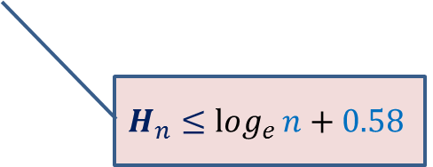
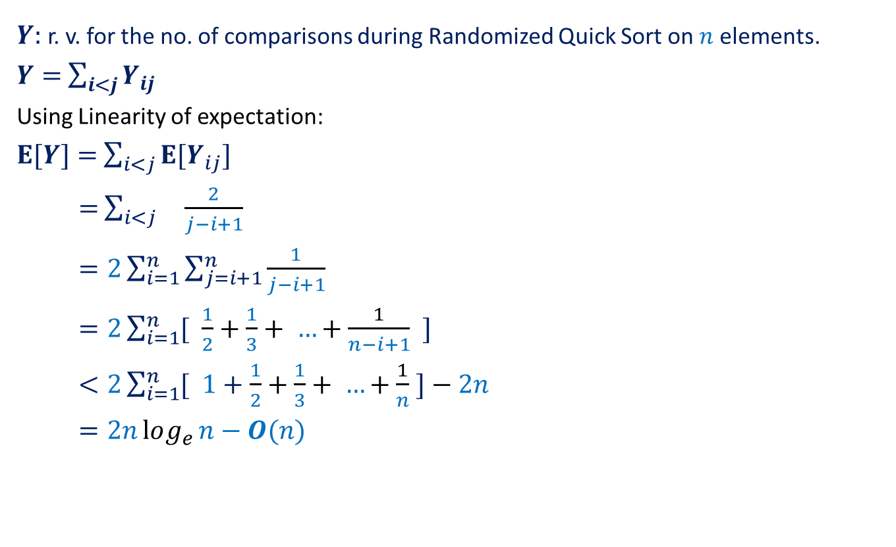
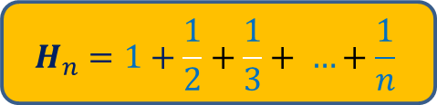
Randomized Quick Sort (number of comparisons)
$Y$: r. v. for the no. of comparisons during Randomized Quick Sort on $n$ elements.
$Y=$ $\sum_{i<j}{Y_{ij}}$
Using Linearity of expectation:
$E[Y]=$ $\sum_{i<j}{{E[Y}_{ij}]}$
$=$ $\sum_{i<j}{ \frac{2}{j−i+1}}$
$=2\sum_{i=1}^{n}{\sum_{j=i+1}^{n}{\frac{1}{j−i+1}}}$
$=2\sum_{i=1}^{n}{[ \frac{1}{2}+\frac{1}{3}+ …+\frac{1}{n−i+1} ]}$
$<2\sum_{i=1}^{n}{[ 1+\frac{1}{2}+\frac{1}{3}+ …+\frac{1}{n} ]}−2n$
$=2nlog_{e}{n}−O(n)$
$$H_{n}=1+\frac{1}{2}+\frac{1}{3}+ …+\frac{1}{n}$$
$$H_{n}≤log_{e}{n}+0.58$$

Slide 21
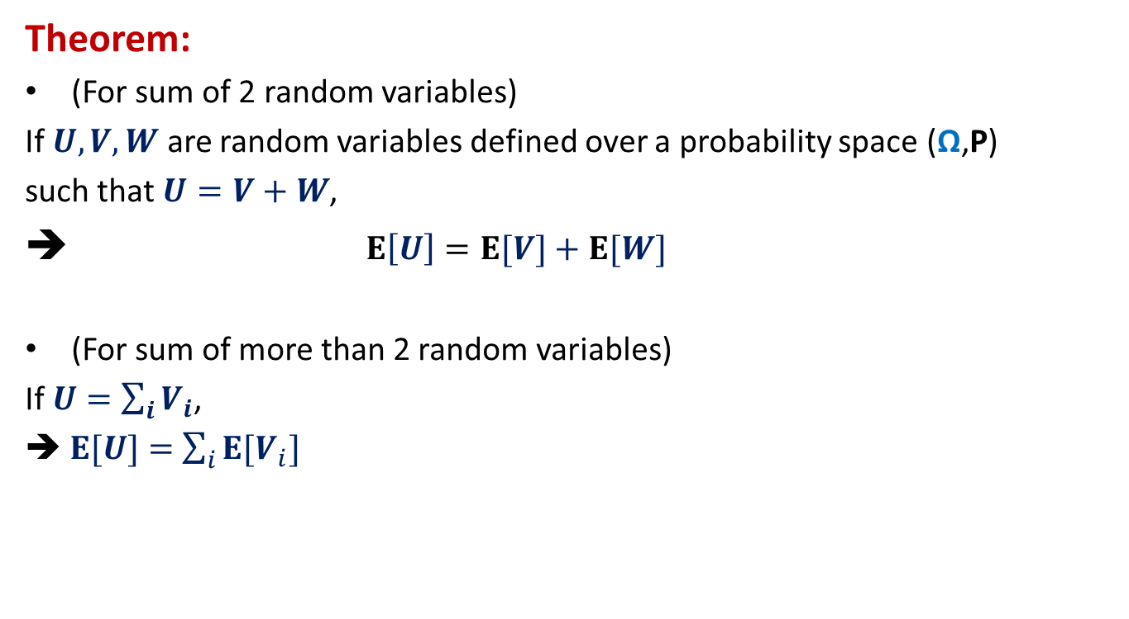
Linearity of Expectation
Theorem:
(For sum of 2 random variables)
If $U,V,W$ are random variables defined over a probability space (Ω,P)
such that $U=V+W$,
➔ $E\left[U\right]=E[V]+E[W]$
(For sum of more than 2 random variables)
If $U=$ $\sum_{i}{V_{i}}$,
➔$E[U]=$ $\sum_{i}{{E[V}_{i}]}$

Slide 22
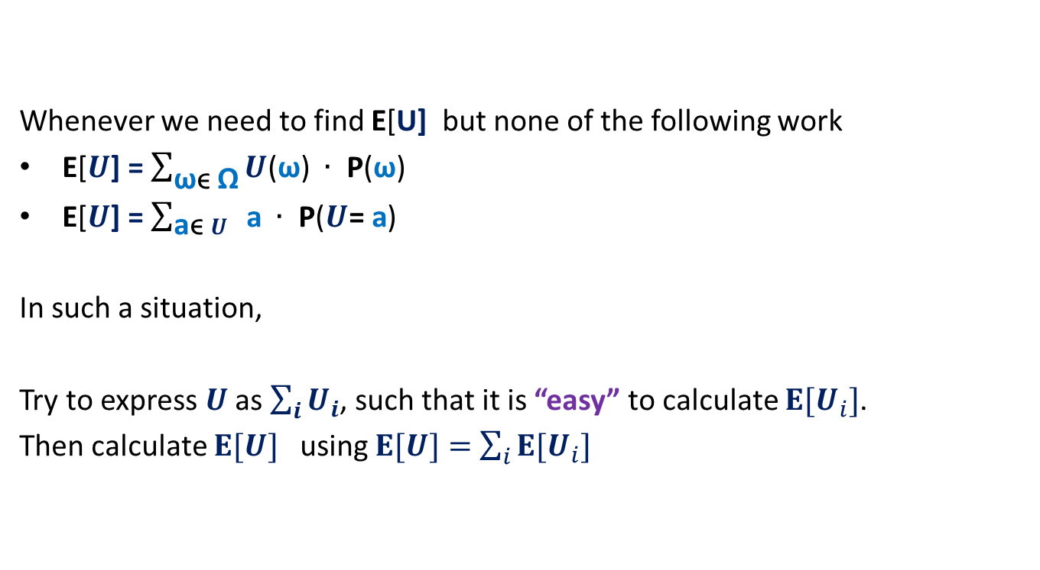
Where to use Linearity of expectation ?
Whenever we need to find E[U] but none of the following work
E[$U$] = $\sum_{\text{ω}\text{ϵ} \text{Ω}}{U\text{(}\text{ω}\text{)} ∙ \text{P}\text{(}\text{ω}\text{)}}$
E[$U$] = $\sum_{\text{a}\text{ϵ} U}{ \text{a} ∙ \text{P}\text{(}U\text{= }\text{a}\text{)}}$
In such a situation,
Try to express $U$ as $\sum_{i}{U_{i}}$, such that it is “easy” to calculate ${E[U}_{i}]$.
Then calculate $E[U]$ using $E[U]=$ $\sum_{i}{{E[U}_{i}]}$

Slide 23
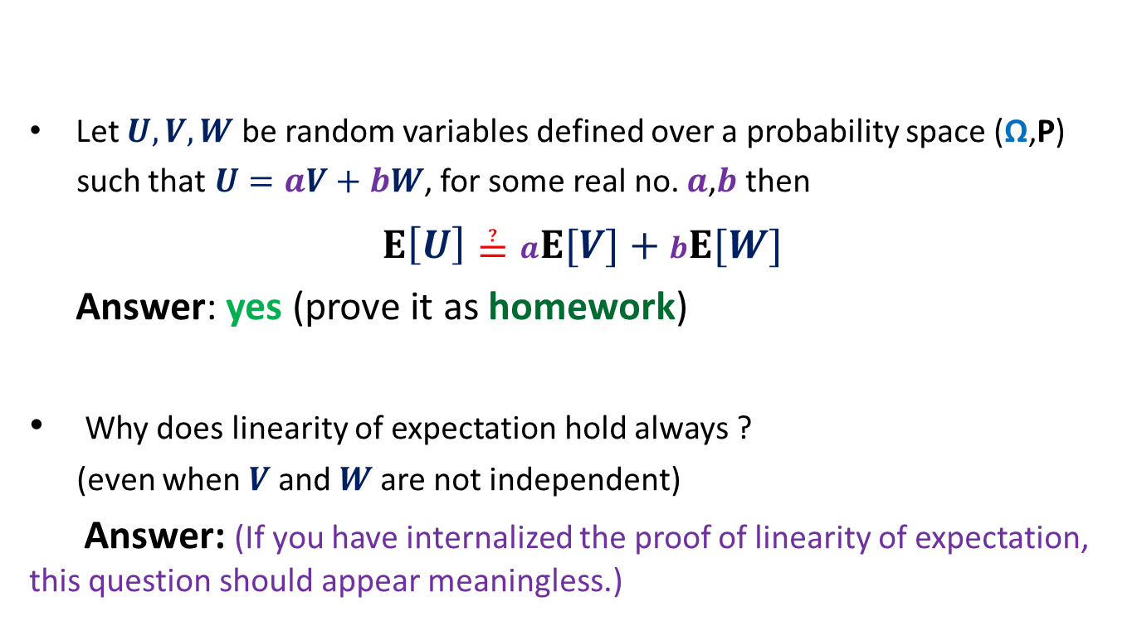
Think over the following questions?
Let $U,V,W$ be random variables defined over a probability space (Ω,P)
such that $U=aV+bW$, for some real no. $a$,$b$ then
$E\left[U\right]≟aE[V]+bE[W]$
Answer: yes (prove it as homework)
Why does linearity of expectation hold always ?
(even when $V$and $W$are not independent)
Answer: (If you have internalized the proof of linearity of expectation, this question should appear meaningless.)

Slide 24
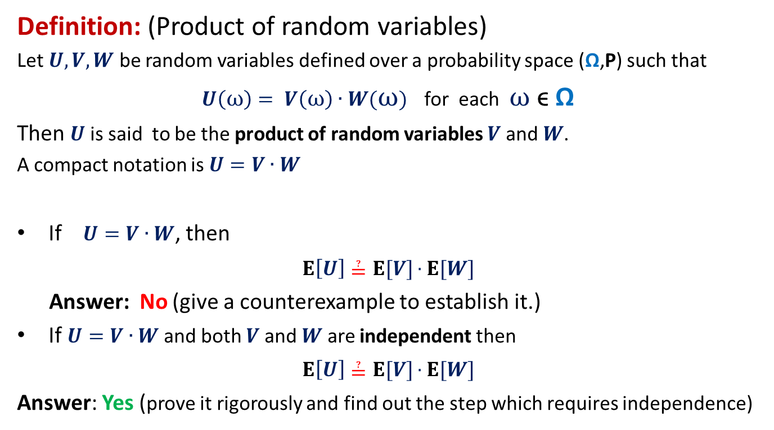
Think over the following questions?
Definition: (Product of random variables)
Let $U,V,W$ be random variables defined over a probability space (Ω,P) such that
$U\left(ω\right)= V\left(ω\right)∙W(ω)$ for each $ω$ ϵ Ω
Then $U$ is said to be the product of random variables $V$ and $W$.
A compact notation is $U=V∙W$
If $U=V∙W$, then
$E\left[U\right]≟E[V]∙E[W]$
Answer: No (give a counterexample to establish it.)
If $U=V∙W$and both $V$ and $W$ are independent then
$E\left[U\right]≟E[V]∙E[W]$
Answer: Yes (prove it rigorously and find out the step which requires independence)

Slide 25
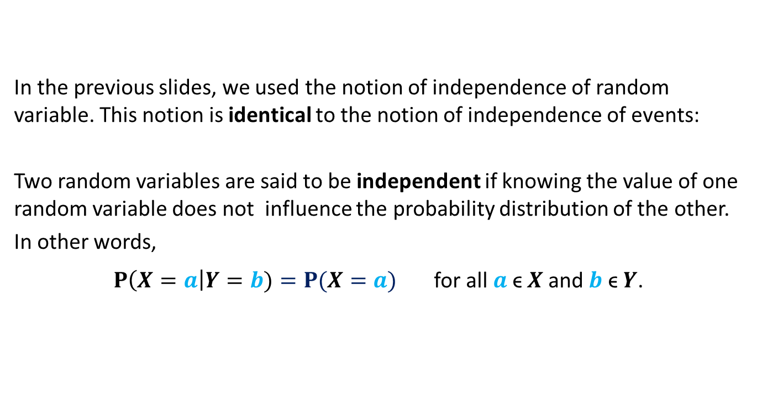
Independent random variables
In the previous slides, we used the notion of independence of random variable. This notion is identical to the notion of independence of events:
Two random variables are said to be independent if knowing the value of one random variable does not influence the probability distribution of the other.
In other words,
$P\left(X=a\right|Y=b)=P(X=a)$ for all $a$ϵ $X$and $b$ ϵ $Y$.

Slide 26
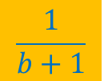

Balls Out of Bin
There is a bin containing $r$ red balls and $b$ blue balls.
Balls are taken out from the bag
Question: What is the probability that appears ahead of all blue balls ?
uniformly randomly
and without replacement.
$$\frac{1}{b+1}$$
To arrive at this answer, how to formalize the intuition :
“the presence of other red balls does not influence this probability”

Slide 27







Balls Out of Bin
any $2$ balls
$1$ … $r+b$
$4$ $7$
$$a$$
: any $2$positions from [$r+b$].
Event $Q_{a}$ :
the two balls are occupying positions specified by $a$
Given that event $Q_{a}$ has happened, what is the distribution of the $2$ balls ?
Try to generalize this claim ?
Uniform among the $2$ slots in $a$

Slide 28
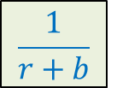










Balls Out of Bin
$$B$$
: any subset of $k$ balls
$1$ … $r+b$
$2$ $4$ $5$ $7$ $9$ $10$
$$a$$
: any subset of [$r+b$] of size $k$
Event $Q_{a}$ :
the balls of set $B$ are occupying positions specified by $a$
How might the balls of set $B$ have been distributed among the slots in $a$ given that $Q_{a}$ has happened ?
$$\frac{1}{r+b}$$
Uniformly among the slots in $a$
What is P[ ] ?
occupies position $7$
What is P[ | $Q_{a}$] ?
$$\frac{1}{k}$$
occupies position $7$
Does not depend on $a$ ☺

Slide 29
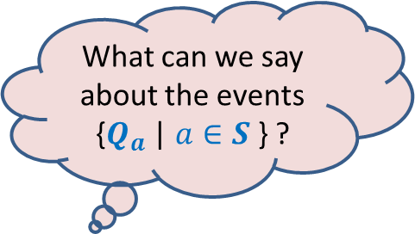

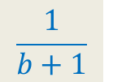



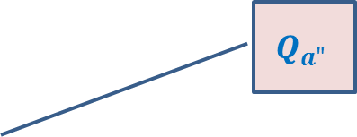

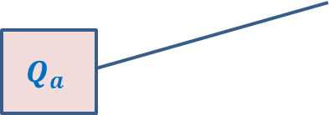
Balls Out of Bin
$E^{∗}$ :
$S$ :
For any $a∈S$, define event
$Q_{a}$ :
$P\left[E^{∗}|Q_{a}\right]$ = ?
$P\left[E^{∗}\right]$ = ?
appears ahead of all blue balls
set of all subsets of [$r+b$] of size $b+1$
all the blue balls and are occupying positions specified by $a$
$1$ $2$ $3$ … … $r+b$
$$\frac{1}{b+1}$$
$$a$$
What can we say about the events
{$Q_{a}$ | $a∈S$ } ?
Set {$Q_{a}$ | $a∈S$ } is a partition of $Ω$.
$$Q_{a"}$$
Ω
$$Q_{a}$$
$$Q_{a′}$$

Slide 30



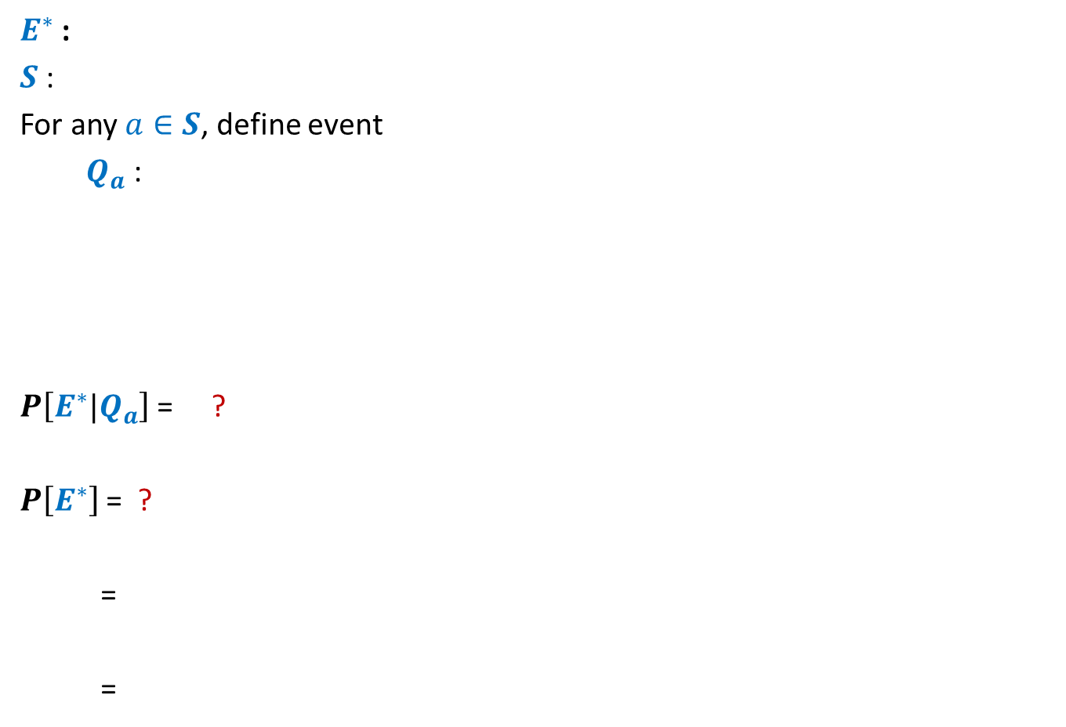
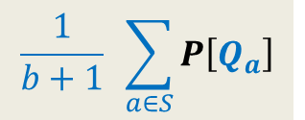
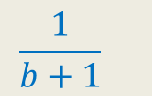
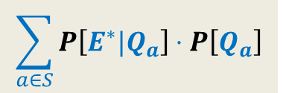
Balls Out of Bin
$E^{∗}$ :
$S$ :
For any $a∈S$, define event
$Q_{a}$ :
$P\left[E^{∗}|Q_{a}\right]$ = ?
$P\left[E^{∗}\right]$ = ?
=
=
appears ahead of all blue balls
set of all subsets of [$r+b$] of size $b+1$
all the blue balls and are occupying positions specified by $a$
$1$ $2$ $3$ … … $r+b$
$$\frac{1}{b+1}$$
$$a$$
$$\sum_{a∈S}{P\left[E^{∗}∩Q_{a}\right]}$$
Set {$Q_{a}$ | $a∈S$ } is a partition of $Ω$.
$$\sum_{a∈S}{P\left[E^{∗}|Q_{a}\right]}⋅P\left[Q_{a}\right]$$
$$\frac{1}{b+1}$$
$1$
$$\frac{1}{b+1} \sum_{a∈S}{P\left[Q_{a}\right]}$$

Slide 31
Very important advice
In case you are not able to follow the solution presented above, do not worry.
Do not try to convince yourself forcefully.
Go over the solution slowly, very very slowly,
and try to give reason on your own for each step.
But in case, you still have difficulty, just forget this solution ☺.
Just think from scratch about the problem and with fresh mind.
Perhaps you will be able to reinvent it or design an alternate solution on your own.
There is no hurry …. ☺….
Some concepts take time to internalize.
So have patience and smile ☺.

Slide 32
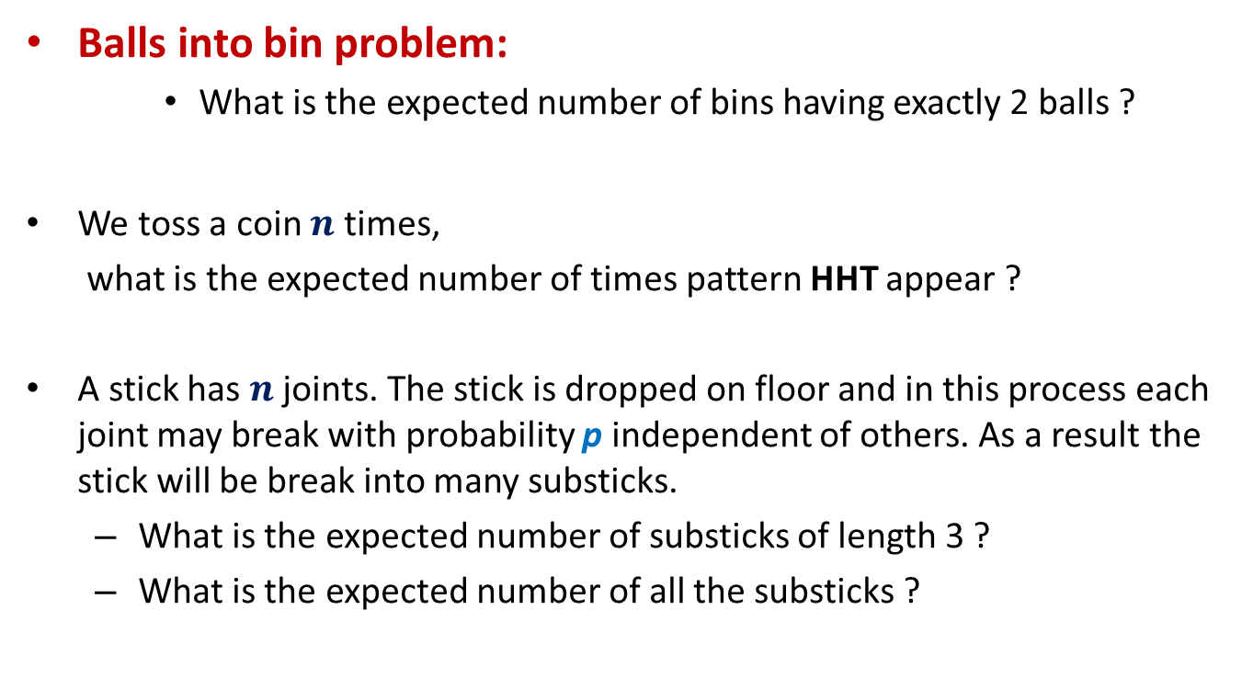
Some Practice problems for Linearity of expectation
Balls into bin problem:
What is the expected number of bins having exactly 2 balls ?
We toss a coin $n$ times,
what is the expected number of times pattern HHT appear ?
A stick has $n$ joints. The stick is dropped on floor and in this process each joint may break with probability p independent of others. As a result the stick will be break into many substicks.
What is the expected number of substicks of length 3 ?
What is the expected number of all the substicks ?

Slide 33
Problems for the next lecture

Slide 34
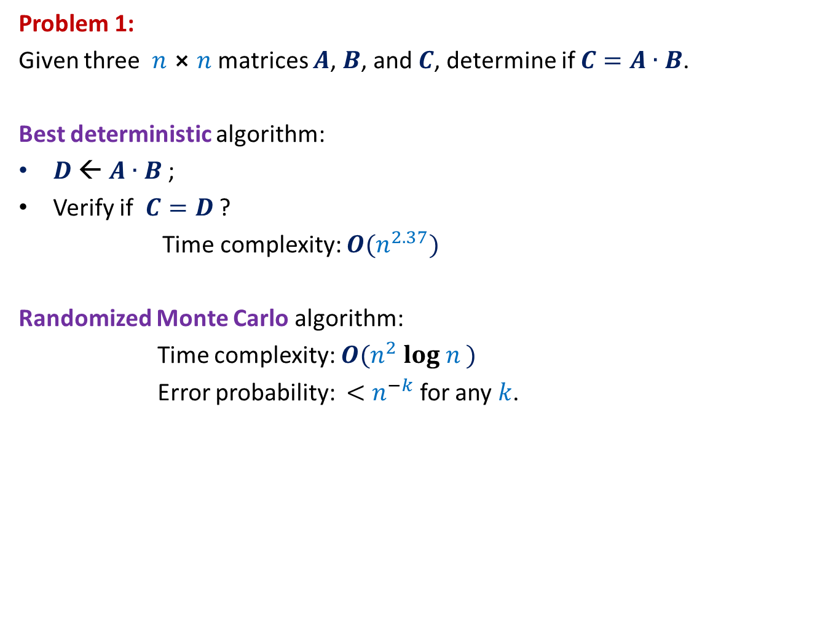
Problem 1:
Given three $n$⨯ $n$matrices $A$, $B$, and $C$, determine if $C=A∙B$.
Best deterministic algorithm:
$D$ ← $A∙B$ ;
Verify if $C=D$ ?
Time complexity: $O(n^{2.37})$
Randomized Monte Carlo algorithm:
Time complexity: $O(n^{2} log n )$
Error probability: ${<n}^{−k}$ for any $k$.

Slide 35





Problem 2:
Aim: To determine if File A identical to File B by communicating fewest bits ?
Network
File A
File B
size(A) = $n$ bits
size(B) = $n$ bits
 | No. of bits to be sent
Deterministic algorithm
$$n$$
Randomized algorithm
O(log($n$))

Slide 36
Lecture 3 ends here.
Ponder over the randomized algorithms for these problems ☺

Slide 41
Fun with probability

Slide 42

Friends, one apple, and a fair coin
Question: How to distribute an apple among friends in a fair manner ?
Easy cases :
No. of friends = 2
No of friends = 4
What if no. of friends = 3?
Toss a coin once and give the apple
to friend A if the outcome is H and
to friend B if The outcome is T
Toss a coin twice and give the apple
to friend A if the outcome is HH and
to friend B if The outcome is HT
to friend C if the outcome is TT
to friend D if the outcome is TH

